Slide 1
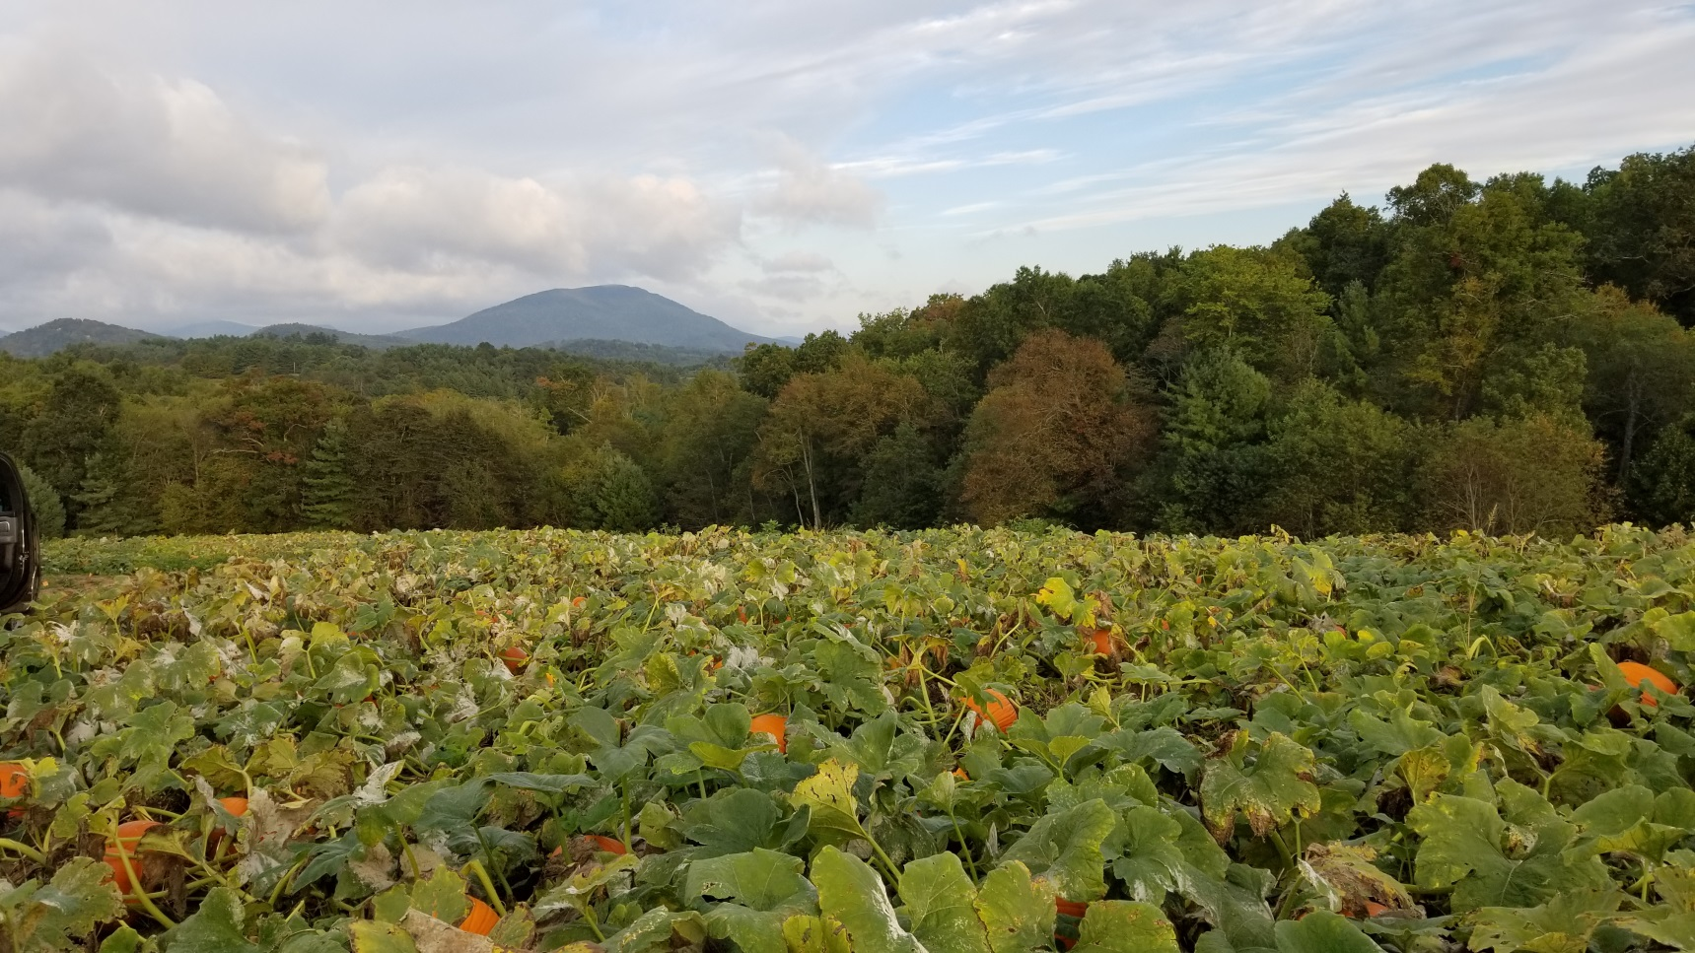
New Varieties For 2020

Slide 2
Questions?
Lauchlin Titus, CPAg
1063 Main Street
Vassalboro, Maine 04989
207 314-2655
lauchlin54@gmail.com

Slide 3
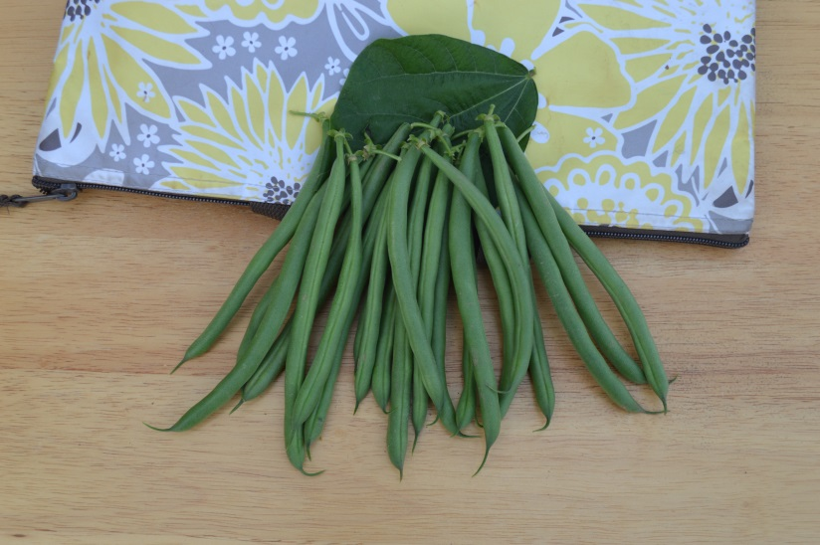
Beans
Greenback(4661)
Limited seed last year – supply good for this year
Exclusive
Strong heat set capability
Less broken pods in packing lines
56 days

Slide 4
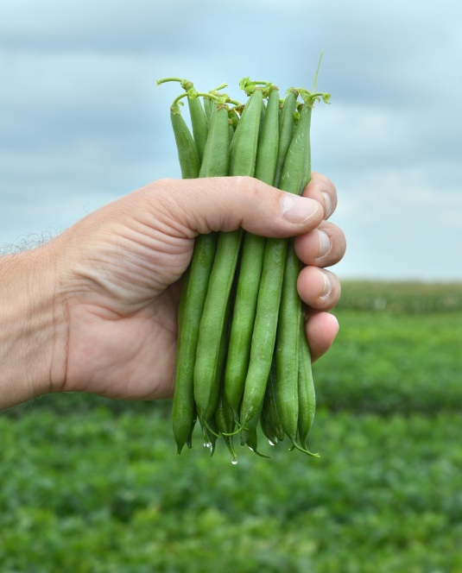
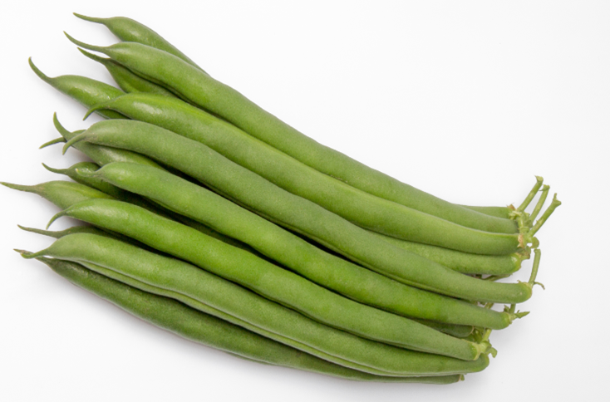
Beans
PV857
Carries rust, one of the few with rust resistance – you will see this as Ua
High yielding
Long pods 6”, you will like the quality
Strong heat set ability, will hold flower in July and August
Delayed delivery - New crop in July with allocation pending
LaSalle(5107)
Very dark pods, tender
Typical upright plant
Bush is open – we think this may help provide less opportunity for disease
Clean harvest
54 days
A lot of disease resistance - BBS, Halo, BCMV

Slide 5
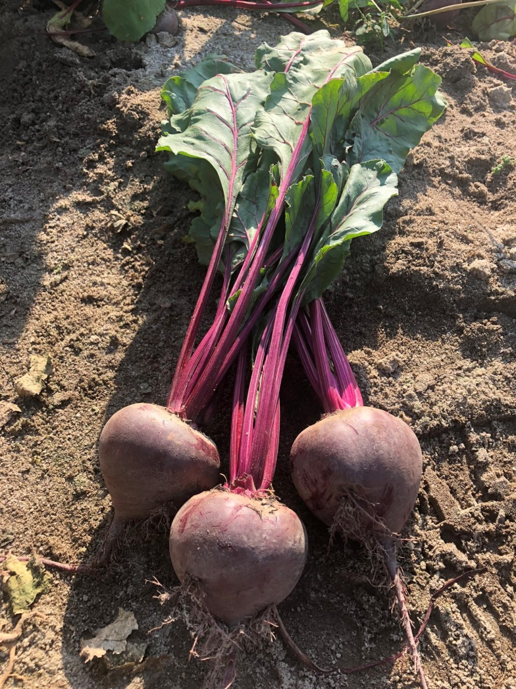
Beets
Bresko
Fresh market beet with 16” tops
Dark red with smooth roots.
Internal characteristics are excellent – no zoning, consistent dark red color
Can be used for baby or medium size roots
Compare to Boro but tops are healthier, taller

Slide 6
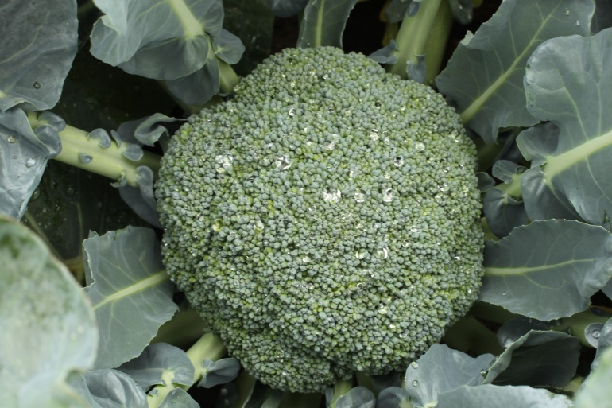
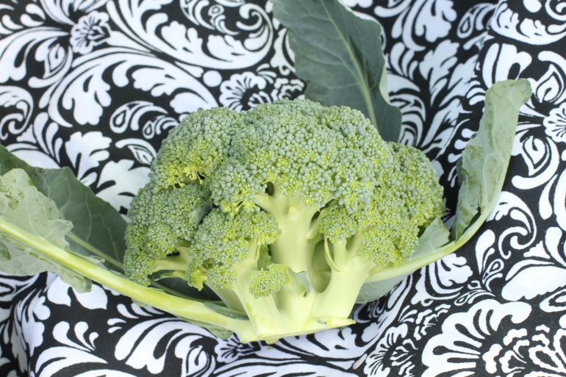
Broccoli
Eastern Crown
We generally like it best when slotted early to main season harvest but is widely adapted
Earlier than Emerald Crown – holds well for an early variety – will hold onto its dark green color even in heat
Can be used in the same main season slot as Emerald Crown
Compact uniform head
A good choice for overall success
60 days

Slide 7
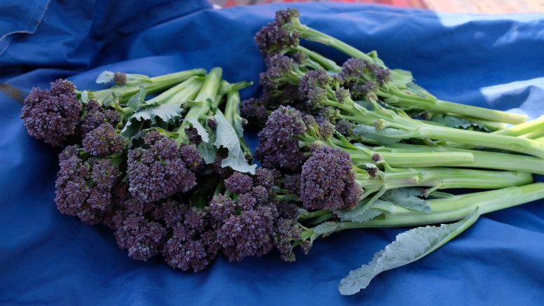
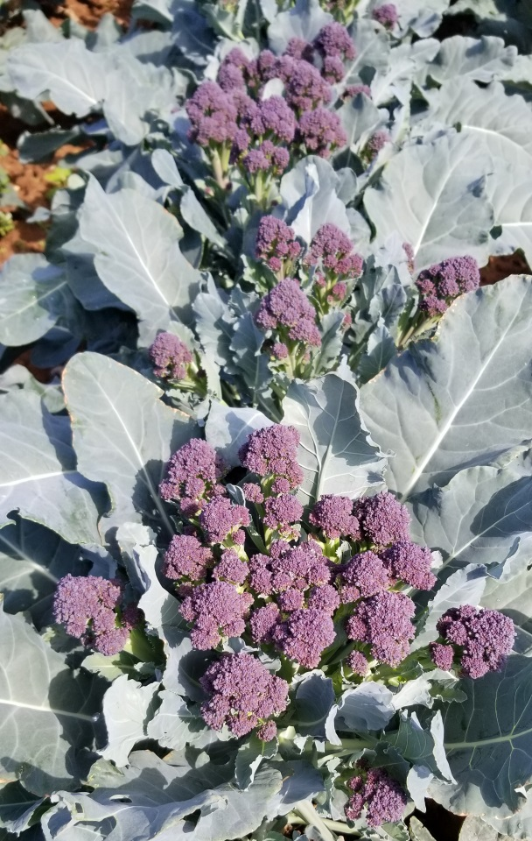
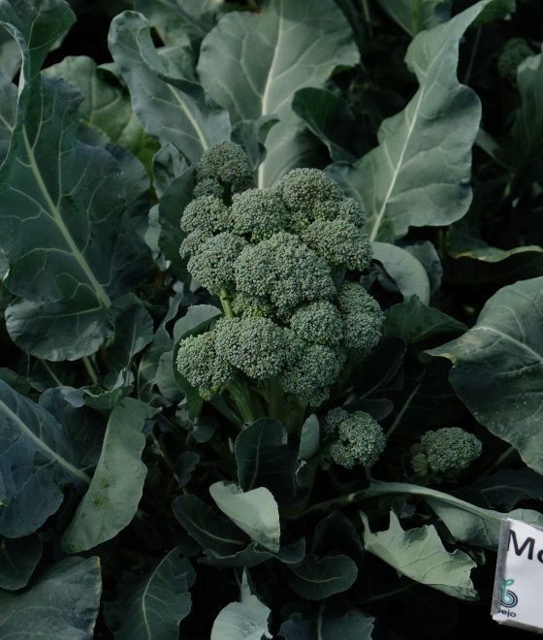
Broccoli
Burgundy
Purple sprouting broccoli
Plant anytime!
Easy to grow
Cut out center head to promote sprout growth. Center head is marketable.
Best color when served raw or lightly steamed. Dark green when fully cooked.
58 days.
Montebello
Green sprouting broccoli
Same type as its purple version, Burgundy
Sweet!

Slide 8
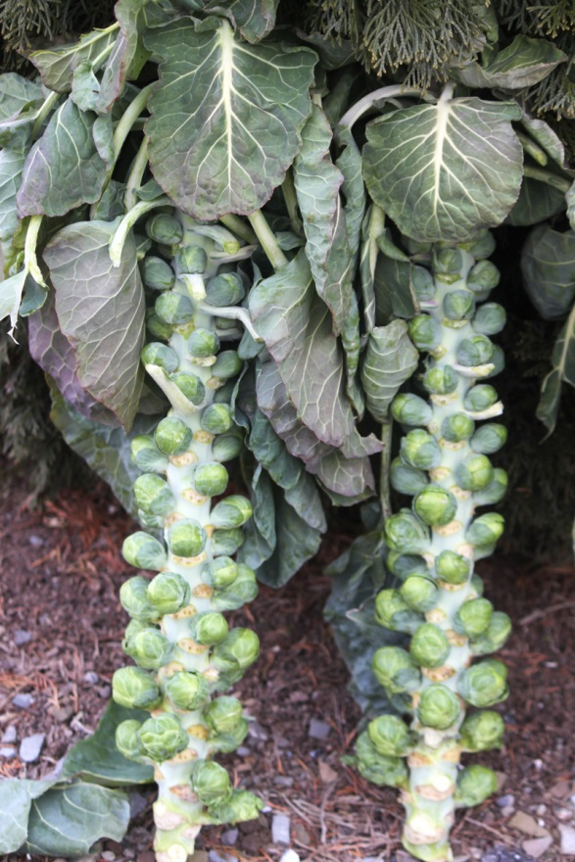
Brussel Sprouts
Dagan
Early variety with a straight stem – can easily be sold as a whole stem
100 days
High quality for early slot – leaves shed as sprouts mature and sprouts are easy to remove from stem
Individual sprouts are firm
Works as a good basic all around sprout

Slide 9
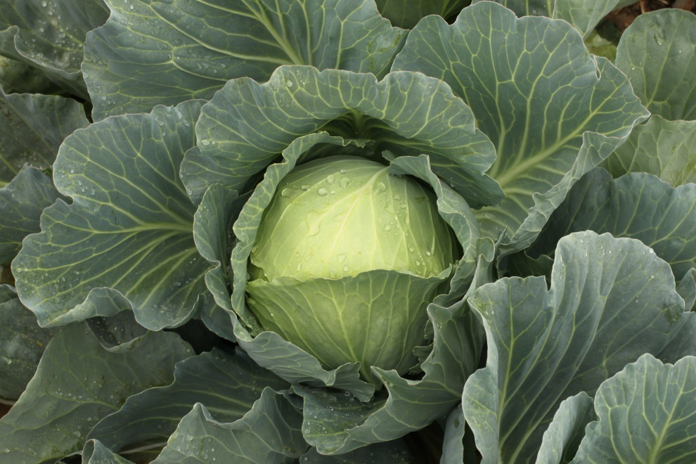
Cabbage
Botran
Fresh market main season, a few days later than Bronco
For those seeking Black Rot resistance – BR higher level than Bronco
Makes box count easy – for super market boxing. Won’t oversize. Grocery store box count is trending toward a higher box count.
Botran is 12 – 20 count

Slide 10
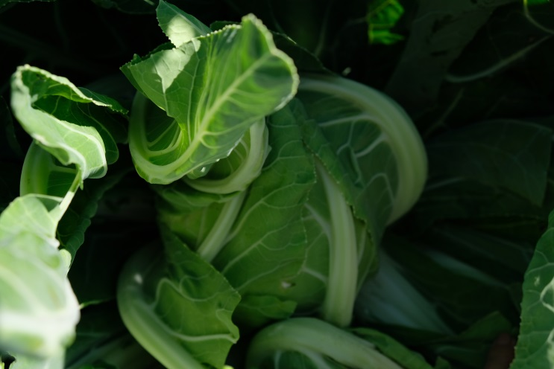
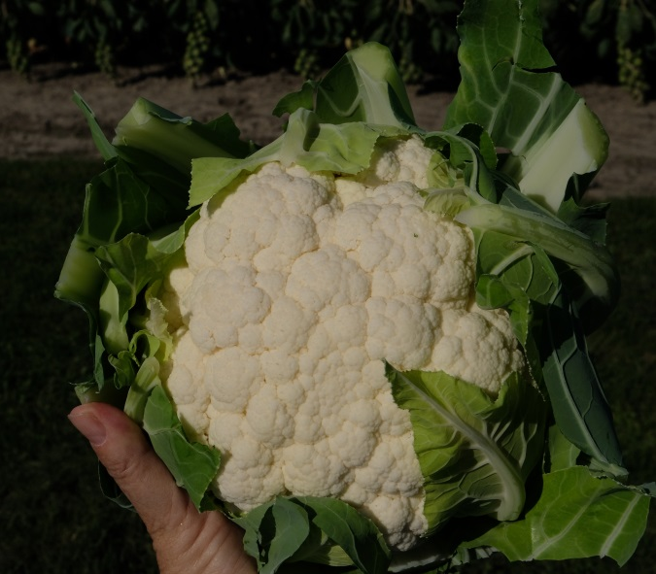
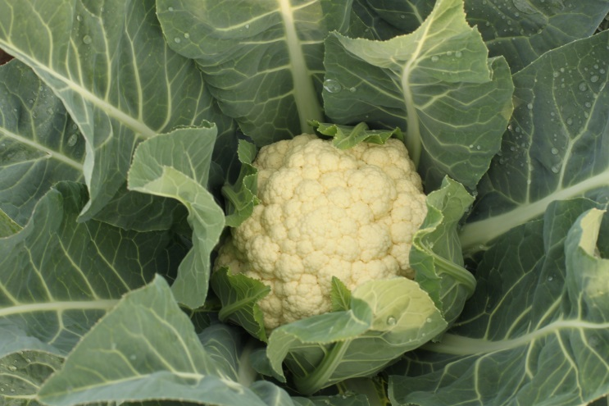
Cauliflower
No Supply Issues
Bermeo
Not new but worth mentioning
Early maturing – similar to Freedom and Steady, 65 days
Strong self-wrap, especially for an early variety
Uniform maturity - concentrated
Heat tolerant
6” heads, dense
Alcala
New
Key point – fully self – wrapping at 12 count size. Head is hidden. May need to be tied if heads continue to size beyond 12 count.
Slightly later than Freedom, earlier than Flamenco
Good heat tolerance
69 days

Slide 11
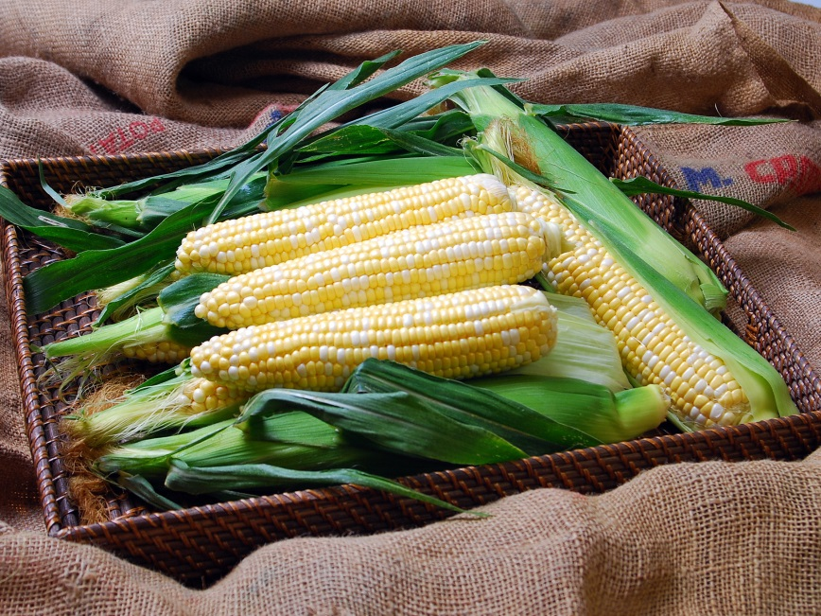
Corn sh2 Bicolor
Solstice
70 days
Strong emergence
Sh2i – this means the seed you plant has more starch in it and better seed quality/ more vigorous
Kickoff alternative if for some reason you don’t like Kickoff
Not a major improvement but does as well in the early sh2
Crookham

Slide 12
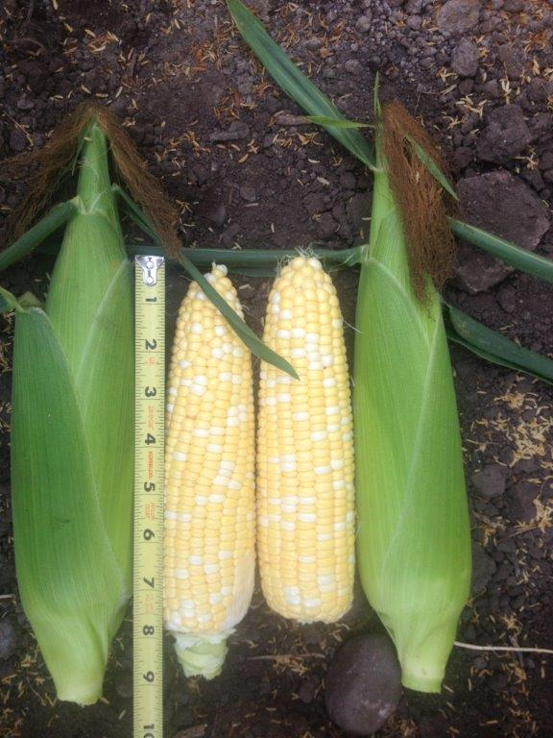
Corn sh2 Bicolor
Anthem XR
Strong grower – first 1-2 plantings, will extend into main season
Widely adapted for an early
Widely used for both early and early main season.
Excellent eating quality
Can be shipped
72 days

Slide 13
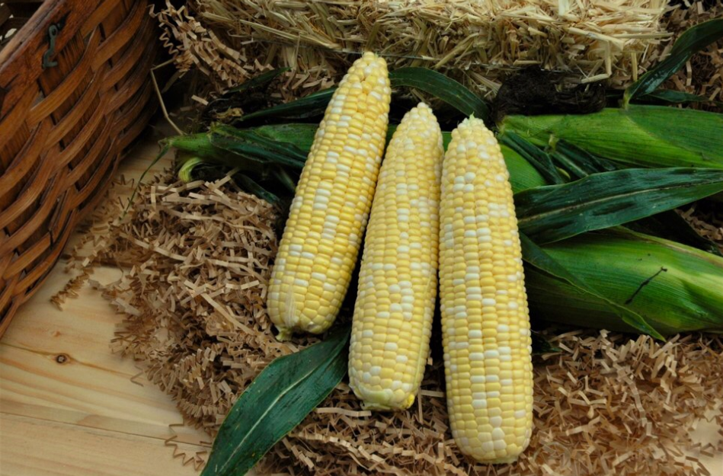
Corn sh2 Bicolor
Signature XR
New and worth looking at if you want an Anthem alternative
Another choice but not a major improvement
IFS
72 days
Exceptional eating quality & tenderness – this would be a step up from Anthem XR
Good field holding ability
HR: Rust(GDJ)

Slide 14
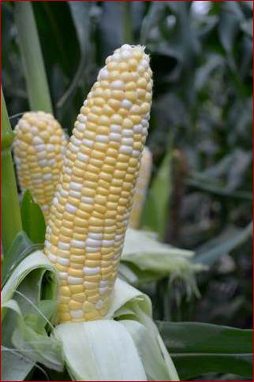
Corn sh2 Bicolor
American Dream
77 days
Replacement for 277A
Looks and acts like 277A, smaller plant
Strong tipfill and tight cover, shorter ear length 7.25”
Like 277a, cover is short but tight
Similar tender and sweet flavor
2018 AAS winner
Not quite as yummy as Kate
Notes:
Rosie – no rust resistance

Slide 15
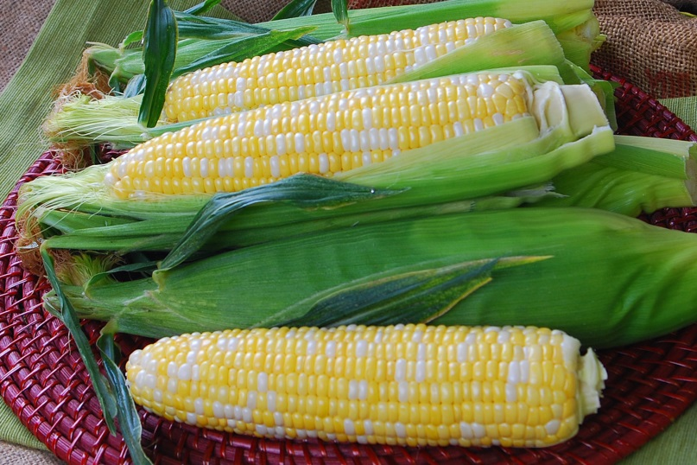
Corn Se Bicolor
Temptress
Early bicolor se – 70 days
Good ear height for early variety
Strong seed vigor
Good eating quality
8” ear
Fancy genetics --Quad Sweet – 100% SE with 44% of the kernels containing high sugar genetics (as opposed to the 25% of Triplesweets)
Can use as Sweetness alternative

Slide 16
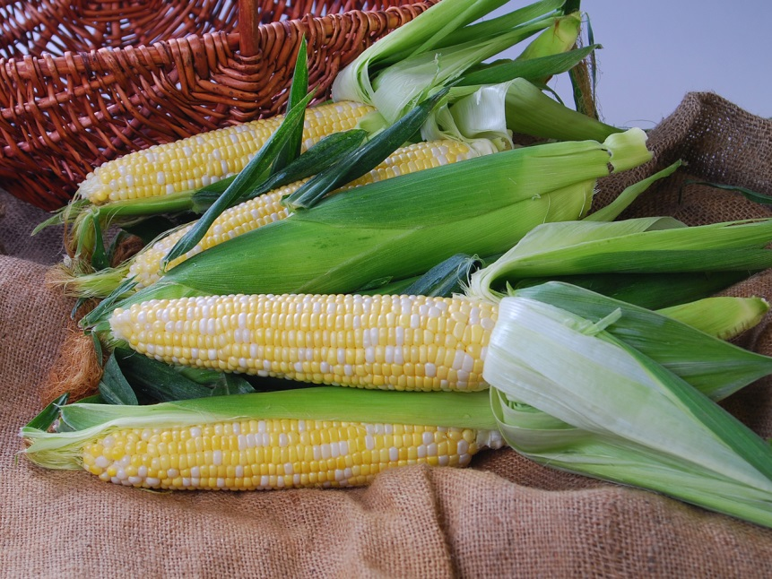
Corn Se Bicolor
Nectar
77 days Quad sweet
Good eating quality with lots of sweetness
Take a look if you use Montauk or Providence – good eating quality
Strong plant for late season
No rust

Slide 17
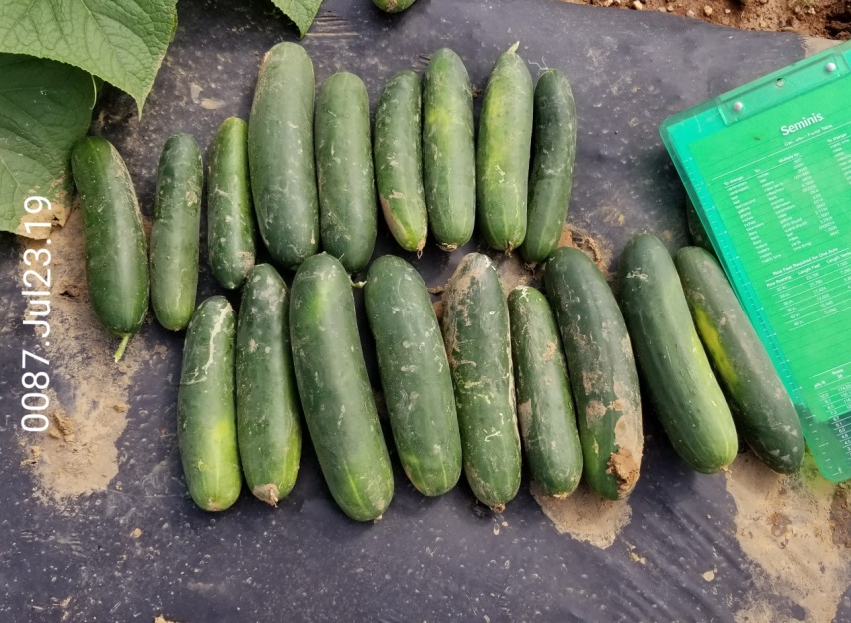
Cucumber
Brickyard
Bristol style slicer, similar length as Bristol
Equal or slightly better level of DM resistance; you will notice this end of season
Fruit shows and maintains dark color and smooth skin throughout multiple picks/extended harvest

Slide 18
Onion
Sweet Jumbos
Expression for sweet jumbo. Stores 3 months. 10% yield increase over Candy due to heavier bulb.
Candy generally does not store but does well with direct field to market sales.
Bulbs over 4”
There is No jumbo sweet red.

Slide 19
Onion
Reds for Jumbo – 3” bulbs
These are the Redwing types. Red Carpet and Red Mountain.
Red Mountain 6 days earlier than Redwing.
These 3 we consider interchangeable. Over 3” – jumbo storage onions.
Color carries through interior and similar to Redwing.
Storage on Red Mountain similar to Redwing.

Slide 20
Peppers
40 count target, 54 place pack
Summary for Bells for Northeast
Lots of new bells in catalog – bells with 1-10 bacteria resistance tend not to make size in the North “sketchy small”. Will require optimum conditions.
Focus varieties:
Playmaker – For best bacteria resistance + PHY.
Turnpike – BLs 1-5 and 7-9 & PHY. Best combination of Phy and BLS resistance. Larger fruit size.
Aristotle, Vanguard still being used
Revolution still being used

Slide 21
Peppers
40 count target, 54 place pack
Playmaker
71 days
First to have PHY and BLS 1-10 – developed specifically for the Northeast
1819 level PHY
Large fruit, 40 count on avg
Playmaker should be managed like Aristotle since the plant and early maturity with concentrated set are similar. Small plant will need to be pushed.
Other varieties with PHY resistance – Turnpike and 1819

Slide 22
Peppers
Turnpike
Compares to 1819 with better fruit shape and a broader disease package of BLS resistance 1-5, 7-9
Offers good Phytophthora resistance, perhaps among the best in the industry
A keeper but can show half long tendency and a “hammered look”
Thick and heavy
1819 type plant
72 days

Slide 23
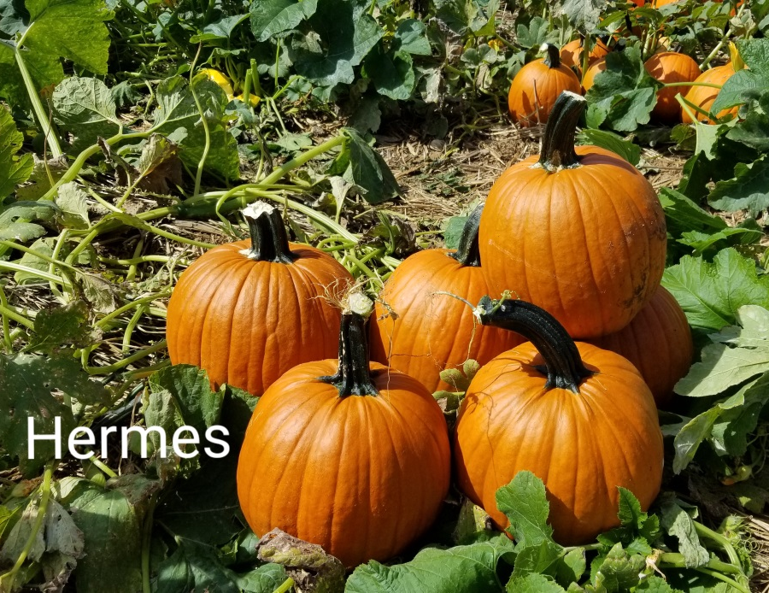
Pumpkins
Hermes
Another option for 50/55 count
10-15 lbs
Cookie cutter uniformity
Top Rated in my 2019 trial!
Seed will be limited & prorated
Restricted vine (catalog FV is typo), almost bush type plant with fruit setting close to crown
IR: PM

Slide 24
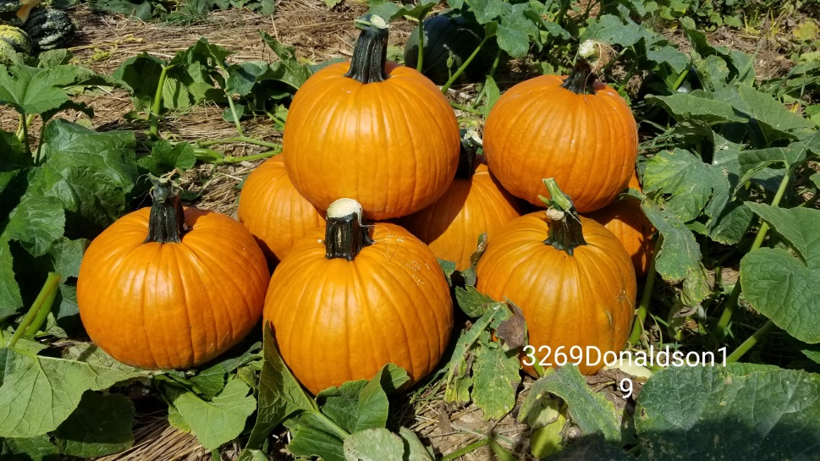
Pumpkins
Spartacus
40 count size, 18 – 22 lbs
This is a blocky round pumpkin with a heavy handle & distinct ribs
Early maturing 100 days
Also top rated in my 2019 trial! It will produce round to round-flat fruit. You will see a size range (comparable to Zeus)
IR: PM, Full vine
Seed availability pending

Slide 25
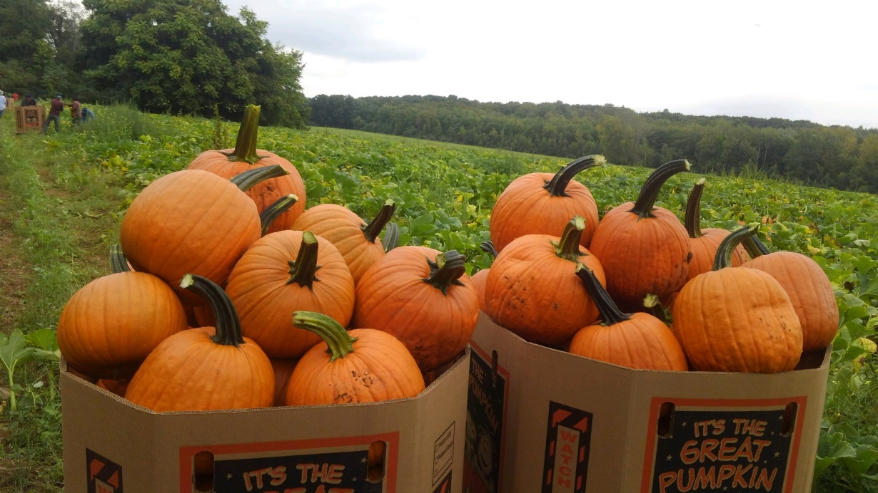
Pumpkins
Sweet Baby Jane
Our new pumpkin, exclusive to Seedway
15 – 25 lbs. Heavy on the 30 count.
Consistent setting ability. Has been grown successfully at 18 to 23 sq/ft per plant
105 – 110 days and IR: PM

Slide 26
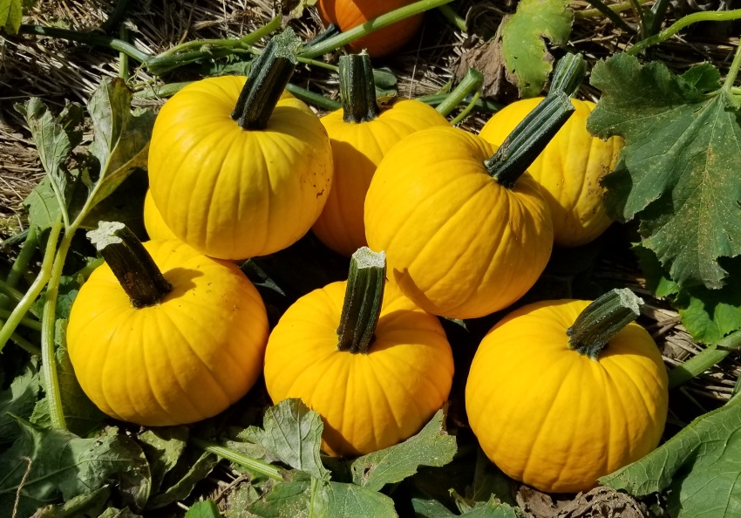
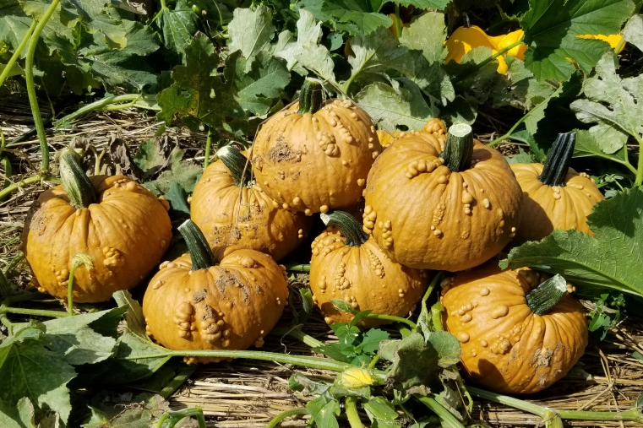
Pumpkins
Grizzley Bear
An internal favorite
Each fruit is consistently warted – I have only seen a few “slick” fruit, even in stressed fields
Warts are hard (not soft like Warty Goblin) so there is less bruising is surface rots
Appealing dark carmel-tan color
100 days, 5 – 10 lbs
IR: PM
Sunlight
We love color! Colored pumpkins are on every porch!
Early – 95 days
4-6 lbs
Yellow to a darker gold-yellow with sun exposure
Uniform size on restricted vine

Slide 27
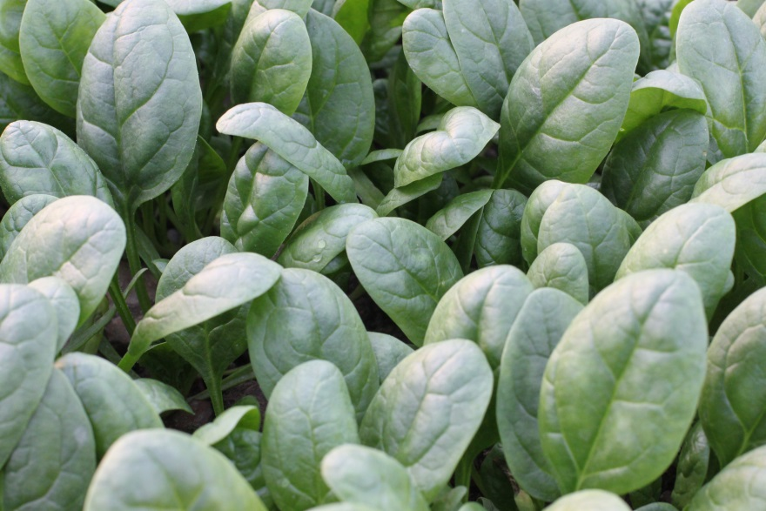
Spinach - babyleaf
Aztec
Semi-savoy
For baby or teen leaf; also can be bunched
Performs well in cooler weather - fall
Downy mildew races 1-15
Banjo : Recommendation for warm weather

Slide 28
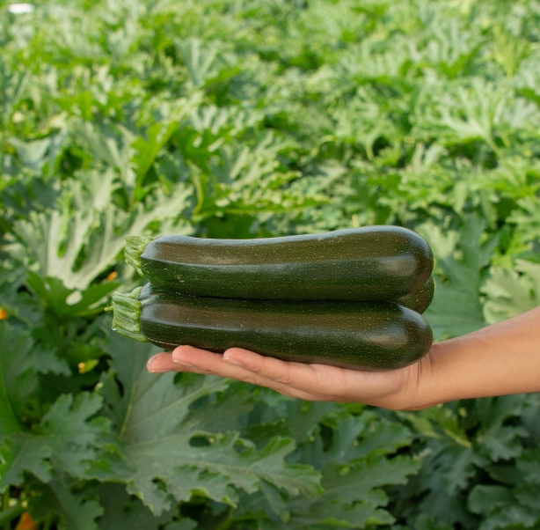
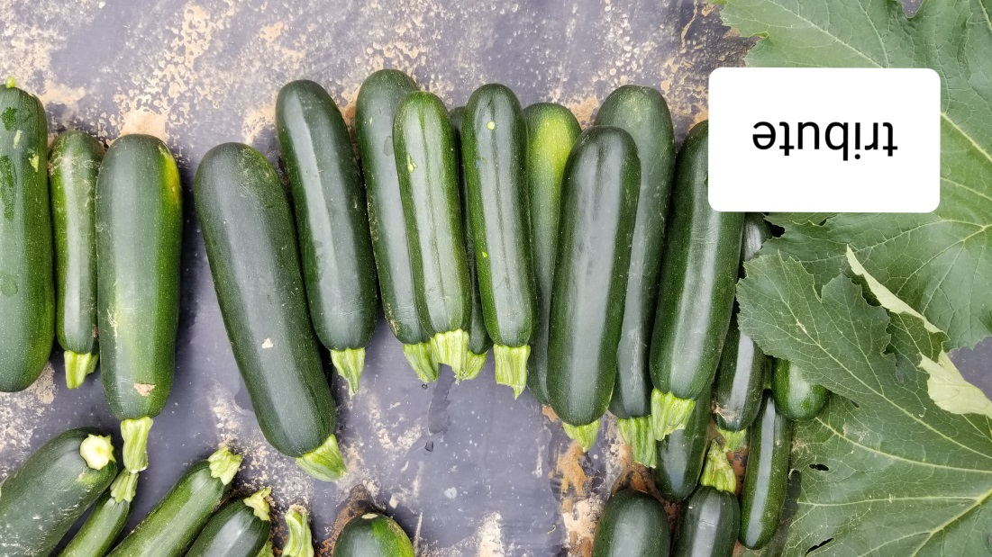
Summer Squash –
Tribute
Very much like Respect with improved disease resistance – Powdery, PRSV, WMV, ZYMV
Behaves like Respect with consistent setting ability
Similar color too – dark green and flecked
First pick was squatty(early July harvest)
No spines
Was 1 pick later than Respect at HTF

Slide 29
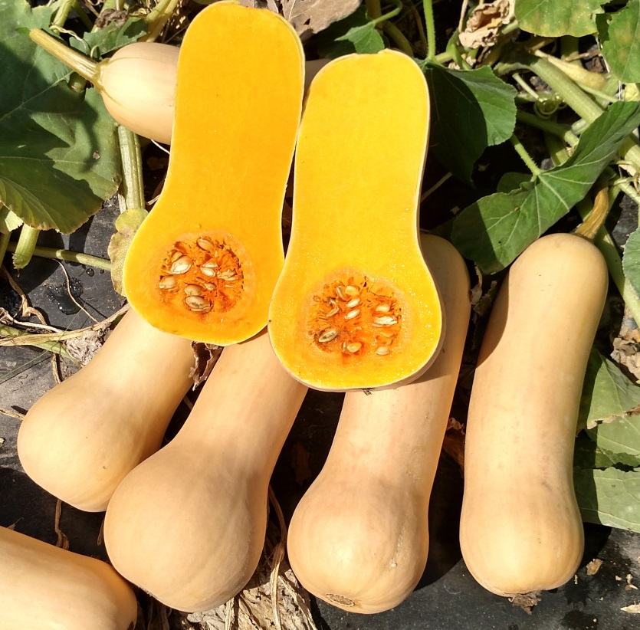
Winter Squash - Butternut
Granite
Growing in popularity for boxing
Straight fruit is very smooth with refined appearance- little to no rib- a plus for peeling applications
Consistent size and slender, “nonblocky” neck boxes easily
Uniformity is amazing and there is very little waste or culls
95 days

Slide 30
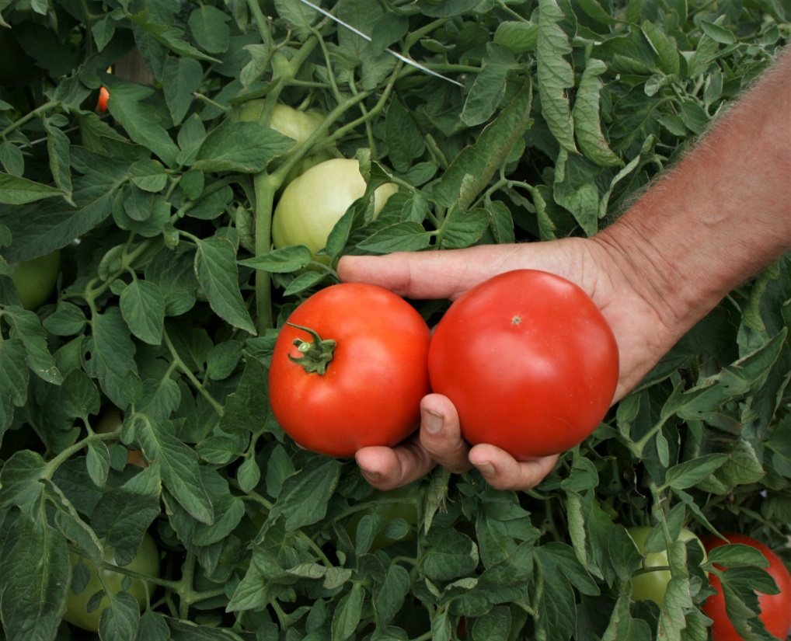
Tomato
Mountain Gem
New
74 days
A roadside or commercial variety with extra-large fruit and clean blossom end
Very red, crimson
From Randy Gardeners program
Flavor is excellent
Vigorous determinate plant
Carries late blight resistance
Most success is with less fertilizer

Slide 31
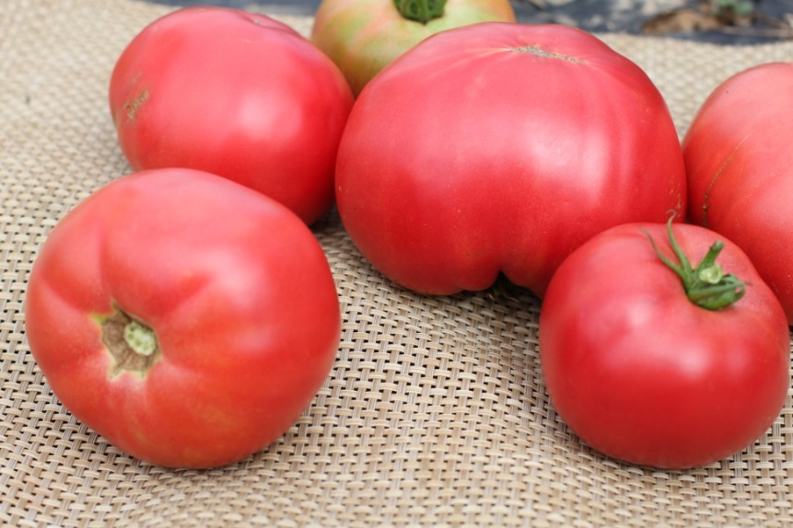
Tomato Heirloom
Mt Rouge
Heirloom hybrid type with smooth fruit, pink
Tasty Brandywine type but cleaner fruit and cleaner blossom end, less green shoulder
Indeterminate plant – do not overfeed or you will get bush and no tomatoes. Starve it.
Late blight and Fusarium 1 resistance.
Light feeding for better productivity to 6’ plant with tomatoes vs. 12’
73 days

